Slide 1
Financed by the Justice Programme of the European Union
gg
STRENGTHENING LAWYERS LEGAL KNOWLEDGE AND COOPERATION WITH PROSECUTORS AND JUDGES, TO PROTECT
VICTIMS OF HUMAN TRAFFICKING RIGHTS IN THE JUDICIAL PROCEEDINGS
Financed by the Justice Programme of the European Union
THE BULGARIAN LEGISLATIVE FRAMEWORK CONCERNING VICTIMS OF HUMAN TRAFFICKING FOREIGN CITIZENs
This publication has been produced with the financial support of the Justice Programme of the European Union. The contents of this publication are the sole responsibility of the author and can in no way be taken to reflect the views of the European Commission
VLADIMIR NIKOLOV Prosecutor
Training Bucharest, Romania, 10-12 May 2017

Slide 2
VICTIMS OF HUMAN TRAFFICKING FOREIGN CITIZENS-
BULGARIA
LEGAL FRAMEWORK- NATIONAL LEGISLATION:
- Constitution of the Republic of Bulgaria;
- Combating Trafficking in Human Beings Act;
- Penal Code;
- Penal Procedure Code;
- Crime Victim Assistance and Financial Compensation Act;
- Law on the Protection of Persons Threatened in connection with Criminal Proceedings;
- Law on Forfeiture in Favor of the State of Illegally Acquired Property;

Slide 3
VICTIMS OF HUMAN TRAFFICKING FOREIGN CITIZENS-
BULGARIA
LEGAL FRAMEWORK- NATIONAL LEGISLATION:
- Legal Aid Act;
- Child Protection Act;
- Social Assistance Act;
- Foreigners in the Republic of Bulgaria Act ;
- Asylum and Refugees Act;
- etc.

Slide 4
VICTIMS OF HUMAN TRAFFICKING FOREIGN CITIZENS-
BULGARIA
FOREIGNER
According to the Bulgarian legislation a FOREIGNER shall be any person who is not a Bulgarian citizen /Article 2, Paragraph 1 of the Foreigners in the Republic of Bulgaria Act/
FOREIGNER shall also be the stateless person- a person who is not considered a citizen by any state according to its legislation /Article 2, Paragraph 2 of the Foreigners in the Republic of Bulgaria Act/.

Slide 5
VICTIMS OF HUMAN TRAFFICKING FOREIGN CITIZENS-
BULGARIA
The foreigners in the Republic of Bulgaria have all rights and obligations according to the Bulgarian laws and the ratified international agreements to which the Republic of Bulgaria is a party except these for which Bulgarian citizenship is required.
The foreigners staying in the Republic of Bulgaria are obliged to observe the laws and the established legal order, to be loyal to the Bulgarian state and not to derogate the prestige and dignity of the Bulgarian people.

Slide 6
VICTIMS OF HUMAN TRAFFICKING FOREIGN CITIZENS-
BULGARIA
The terms and the procedure for providing protection to foreigners in the territory of the Republic of Bulgaria are set out in a special Act- Asylum and Refugees Act.
Republic of Bulgaria subject to compliance with this act provides international protection and temporary protection /Article 1a of the Asylum and Refugees Act/.

Slide 7
VICTIMS OF HUMAN TRAFFICKING FOREIGN CITIZENS-
BULGARIA
COORDINATION MECHANISMS
In the Republic of Bulgaria are built and operate the following three coordination mechanisms:
1. National Mechanism for Referral and Assistance of the victims of trafficking /Coordinator: the National Commission for Combating Trafficking in Human Beings/;
2. Coordination Mechanism for Referral and Care of cases of unaccompanied children and children- victims of trafficking, returning from abroad /Coordinators: the State Agency for Child Protection and the Ministry of Interior/;
3. Trans- national Mechanism for Identification and Referral of victims of trafficking
/Contact point for Bulgaria: the National Commission for Combating Trafficking in Human
Beings/.

Slide 8
VICTIMS OF HUMAN TRAFFICKING FOREIGN CITIZENS-
BULGARIA
THE VICTIMS OF TRAFFICKING IN HUMAN BEINGS FOREIGN CITIZENS HAVE AT DISPOSAL THE FOLLOWING GROUPS OF RIGHTS:
1. Rights of a victim under the Combating Trafficking in Human Beings Act- period of rumination, accommodation in a shelter, right to stay, right to be informed by the prosecutor about their rights;
2. Rights of an "identified" victim within the meaning of the National Mechanism for Referral and Assistance of the victims of trafficking, which includes short and long term psychological and social support;
3. Right to a state-funded legal aid;

Slide 9
VICTIMS OF HUMAN TRAFFICKING FOREIGN CITIZENS-
BULGARIA
4. Right to a state-funded compensation for pecuniary damages;
5. Rights of an "injured" and "witness" within the meaning of the Bulgarian Penal Procedure Code;
6. Right to file claims on compensation for pecuniary and non-pecuniary damages against the trafficker.

Slide 10
VICTIMS OF HUMAN TRAFFICKING FOREIGN CITIZENS-
BULGARIA
STATUTE OF SPECIAL PROTECTION
Individuals who have become victims of trafficking in human beings and have declared their willingness to collaborate for disclosure of the trafficking perpetrators shall be granted special protection statute for the term of the criminal proceedings, including:
1. Provision of a permission to foreign nationals for long-term stay in the country;
2. Extension of the accommodation period in the shelters /Article 25 of the Combating Trafficking in Human Beings Act/.

Slide 11
VICTIMS OF HUMAN TRAFFICKING FOREIGN CITIZENS-
BULGARIA
The permit for continuous stay shall be issued by the order of the Foreigners in the Republic of Bulgaria Act by the respective offices for administrative control at the Ministry of Interior.
For the term of their stay the persons, having obtained permission for a long-term stay in the country shall exercise the rights of permanently staying in the meaning of the Foreigners in the Republic of Bulgaria Act.
Permit shall not be issued to persons who do not possess identification documents and refuse collaboration for establishing their identity.

Slide 12
VICTIMS OF HUMAN TRAFFICKING FOREIGN CITIZENS-
BULGARIA
According to Article 24 of the Foreigners in the Republic of Bulgaria Act a long-term residence permit in Bulgaria may be granted to foreigners who have acquired statute of special protection under the condition of Article 25 of the Combating Trafficking in Human Beings Act.

Slide 13
VICTIMS OF HUMAN TRAFFICKING FOREIGN CITIZENS-
BULGARIA
As can be seen from the legal framework presented, cooperation with the competent authorities is a condition for issuing residence permits to trafficked persons.
Once granted the special protection status and the residence permit, victims of trafficking who are foreign citizens are guaranteed that they will not be removed from the country unless they wish so.
If foreign victims do not wish to cooperate, they will be forced to leave the country unless they are legally resident, for example they have a visa with which they have entered the country

Slide 14
VICTIMS OF HUMAN TRAFFICKING FOREIGN CITIZENS-
BULGARIA
REFUGEES
Although not all victims are refugees, some victims of trafficking may need international protection.
Victims of trafficking may be unable to return to their country of origin because of real fear of repeated victimization and re-trafficking. They may be afraid of excommunication, stigmatization, punishment by the family, the community or even the authorities. Such fear may be well founded and may lead to the victim's persecution, thus triggering the granting of international protection under the Asylum and Refugees Act.

Slide 15
VICTIMS OF HUMAN TRAFFICKING FOREIGN CITIZENS-
BULGARIA
THE HUMAN TRAFFICKING AND OTHER EXPLOITATIVE PRACTICES PREVALENCE INDICATION SURVEY FOR 2016
MAIN FINDINGS CONCERNING EASTERN MEDITERRANEAN ROUTE:
- 14% of individuals answered “yes” to one of the trafficking and other exploitative practices indicators, based on their own direct experience;
- 0.8% of respondents had a member of their family travelling with them, who experienced situations captured by one of the trafficking and other exploitative practices indicators;
- 5% of respondents responded positively to at least 2 of the trafficking and other exploitative practices indicators.

Slide 16
VICTIMS OF HUMAN TRAFFICKING FOREIGN CITIZENS-
BULGARIA
The experiences captured by the human trafficking and other exploitative practices prevalence indicator questions are reported by respondents as mostly taking place in Turkey, but also in Greece and Bulgaria.
The profile and experiences of the respondents who answered “yes” to one of the trafficking and other exploitative practices indicator-questions, based on the respondents’ own experience on the Eastern Mediterranean route:
- Nationality: Highest rates of positive response are amongst Moroccans (18%), Algerians (18%), Afghans (15%), Syrians (12%) and Iranians (12%).
- Age: Positive response rates are higher for adolescent youth (18%) than for adults (12%).
- Sex: Rates of positive response to a trafficking or other exploitative practices indicator are slightly higher amongst men (9% of women responded positively, and 15% of men).

Slide 17
VICTIMS OF HUMAN TRAFFICKING FOREIGN CITIZENS-
BULGARIA
The Council of Europe Convention on Action against Trafficking in Human Beings explicitly states that victims of trafficking should not be returned to a country where there is a serious risk of being subjected to persecution, torture or other forms of ill-treatment. The Convention also reaffirms the right of victims of trafficking to seek and obtain asylum.
Before a victim of trafficking is returned or deported to the country of origin, Member States must be aware that such action will not expose the victim to any of the above mentioned risks.
In this sense, it is of the utmost importance to identify victims of trafficking among refugees and to give them the opportunity to take advantage of their rights to a period of rumination/reflection, shelter, social and psychological support, a ban on detention and prosecution.

Slide 18
VICTIMS OF HUMAN TRAFFICKING FOREIGN CITIZENS-
BULGARIA
RIGHT TO INTERPRETATION/ TRANSLATION
Language, in which the penal procedure shall be conducted
According to Article 21 of the Bulgarian Penal Procedure Code the criminal procedure shall be conducted in the Bulgarian language.
The persons, who do not speak Bulgarian language, may use either their native or another language. In such case, an interpreter shall be appointed.

Slide 19
VICTIMS OF HUMAN TRAFFICKING FOREIGN CITIZENS-
BULGARIA
PRACTICAL PROBLEMS.
Right now Bulgarian law enforcement experience serious practical difficulties concerning ensuring the victims, who do not speak Bulgarian language, right to information in the context of providing these people with translation or interpretation.
Because of the fact that Bulgaria has a common border with Turkey, thousands of migrants from Syria, Iraq, Afghanistan, Pakistan, etc. try to reach EU countries via Bulgaria. Many of these people speak different exotic languages and dialects and that is why for the authorities is sometimes extremely difficult to fulfil their duties and obligations.
In some parts of the country there is certain lack of well educated and skillful interpreters and translators which may result in blocking of some proceedings.

Slide 20
VICTIMS OF HUMAN TRAFFICKING FOREIGN CITIZENS-
BULGARIA
LAW AND PRACTICES RELATING TO LEGAL ASSISTANCE AND LEGAL AID TO VICTIMS OF TRAFFICKING
The Bulgarian LEGAL AID ACT regulates the legal assistance in criminal, civil and administrative cases before all courts. According to it:
The legal assistance shall be exercised by lawyers and funded by the state.
The purpose of the law is to ensure equal access to justice by ensuring and providing effective legal assistance.
The funds for legal assistance shall be provided from the state budget.

Slide 21
VICTIMS OF HUMAN TRAFFICKING FOREIGN CITIZENS-
BULGARIA
When the right arises
The right to free legal consultation for victims arises from the moment of their identification as victims. This is the time, when the state authorities are obliged to inform them of their right to legal aid, the services to which they can turn in order to exercise that right, and the terms and procedures for obtaining legal aid free of charge.

Slide 22
VICTIMS OF HUMAN TRAFFICKING FOREIGN CITIZENS-
BULGARIA
Procedure and competent authority
The competent authorities organizing the provision of legal aid are the National Legal Aid Bureau and the regional Bar Associations. The National Legal Aid Bureau keeps a National Legal Aid Register for the lawyers designated to provide legal aid at the district of each district court.
In order to be granted free legal aid, the victim should file a request to the Bureau along with the required supporting documents.
The decision to grant legal aid is taken by the President of the Bureau within 14 days after submission of all required documents. This decision is then forwarded for appointment of an attorney to the competent Bar Association depending on the court district where proceedings would legally take place.

Slide 23
VICTIMS OF HUMAN TRAFFICKING FOREIGN CITIZENS-
BULGARIA
Eligibility criteria for provision of primary legal aid
Pursuant to the Legal Aid Act victims of human trafficking are entitled to free legal aid if “they do not have means to pay and wish to avail themselves of the assistance of a lawyer”. However, the act does not give particular instructions on the manner of proving the lack of means to pay for legal assistance.

Slide 24
VICTIMS OF HUMAN TRAFFICKING FOREIGN CITIZENS-
BULGARIA
Legal representation in pre-trial phase of criminal proceedings
The pre-trial phase of criminal proceedings includes the pre-trial activities of the prosecutor and the organs of the pre-trial investigation (investigators and the organs of the police investigation). Its aim is to establish the objective truth of the circumstances on the case, to collect and secure the evidence, necessary for making the decision whether to take the suspect to court and for the completion of the court proceedings in the trial phase with a just sentence.
The Bulgarian Criminal Procedure Code and the Leal Aid Act do not explicitly regulate the right of the victim to be assigned a legal representative during the pre-trial phase. In practice, however, prosecutors review the qualification requirements for granting free legal aid and determine on granting legal aid to victims of crimes in a similar manner as free legal aid is granted to the accused. The legal grounds used for the purpose is the provision of article 75 of the Criminal Procedure Code on the rights of the victim, encompassing among others the right to legal counsel.

Slide 25
VICTIMS OF HUMAN TRAFFICKING FOREIGN CITIZENS-
BULGARIA
Legal representation before court
Procedure and competent authority
In criminal trial, the court is the competent authority to rule on the provision of free legal aid to the victim in its capacity of ‘injured party’, ‘private prosecutor’ and/or ‘civil claimant’.
The legal preconditions for appointing a counsel by the court are (i) presentation of evidence of not having sufficient funds to hire a lawyer, and (ii) if the interests of justice so require.

Slide 26
VICTIMS OF HUMAN TRAFFICKING FOREIGN CITIZENS-
BULGARIA
The Legal Aid Act further elaborates on the conditions for granting legal aid, setting forth the following circumstances to be considered by the court:
income accruing to the victim or their family;
property status, as certified by a declaration;
marital status;
state of health;
employment;
age;
other circumstances.
After the court rules on the granting of legal aid, the ruling is immediately sent to the Bar association within the district of the court for appointment of an attorney.

Slide 27
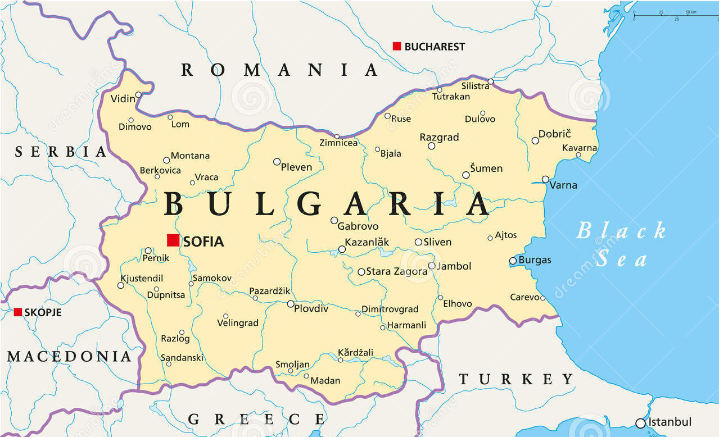

Slide 28
THE RIGHT TO INFORMATION IN CRIMINAL PROCCEDINGS. Bulgarian experience.
THANK YOU VERY MUCH FOR THE ATTENTION!

Slide 29
PROSECUTORS’ OFFICE OF REPUBLIC OF BULGARIA. Regional Prosecutors’ Office of Pleven.
VLADIMIR NIKOLOV
Head of the Regional Prosecutors’ Office of Pleven
5800 Pleven, Republic of Bulgaria
+ 359889114964; vladimir.nikolov.pl@gmail.com

